Slide 1
Burgundy
COS 214 Final Project
by
Lerato Gololo · Brenden van der Mescht · Siyamthanda Ndlovu Katlego Zondo · Sechaba Ntshehi
Group 24

Slide 2
Burgundy
Customer should be able to :
Walk in an request to be seated
Be assigned to a table
Create an order and then place it by sending it to the waiter
Specify ingredients and remove or add to the order prior to it being sent to the kitchen
Tell a waiter to come back later if they are not ready to order
Split the bill or pay it in full
Decide on payment method (by tab or pay immediately)
Receive their order and eat it
System Requirements

Slide 3
Burgundy
Design Patterns
Mediator
State
Strategy
Chain of Responsibility
Memento
Observer
Builder
Decorator
Iterator
Factory Method

Slide 4
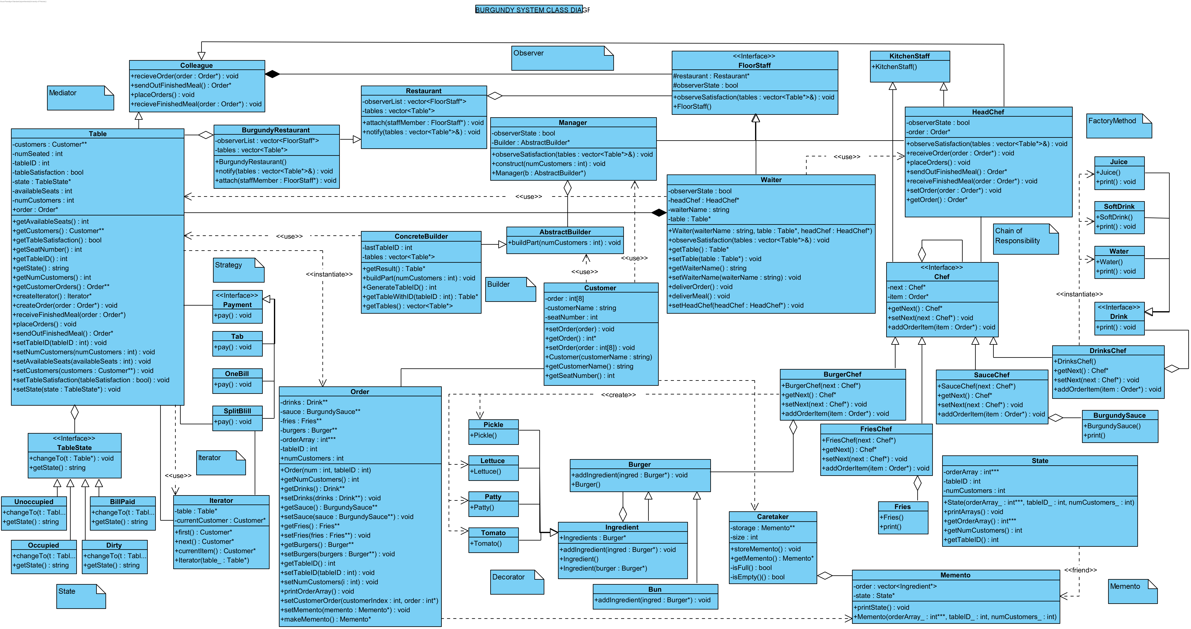
Burgundy Class Diagram

Slide 5
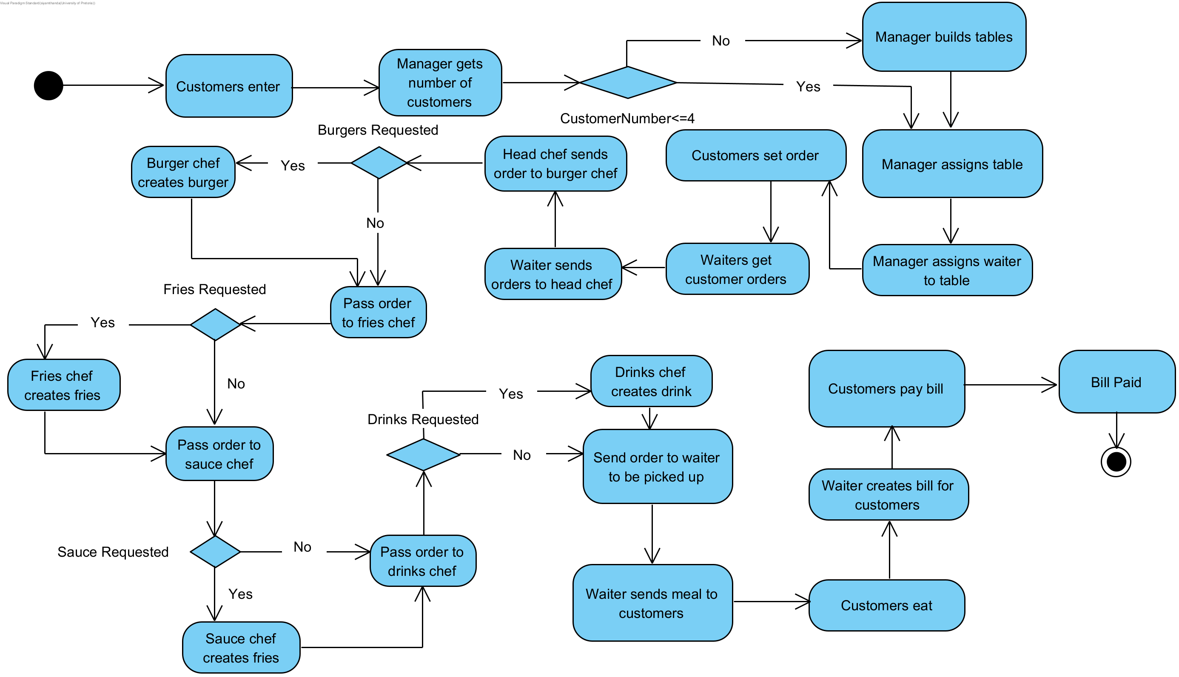
Burgundy Activity Diagram

Slide 6
Burgundy
COS 214 Final Project Report
by
Lerato Gololo · Brenden van der Mescht · Siyamthanda Ndlovu Katlego Zondo · Sechaba Ntshehi
Group 24

Slide 7
Functional Requirements & Design Patterns
The system requirements and the corresponding design patterns used

Slide 8
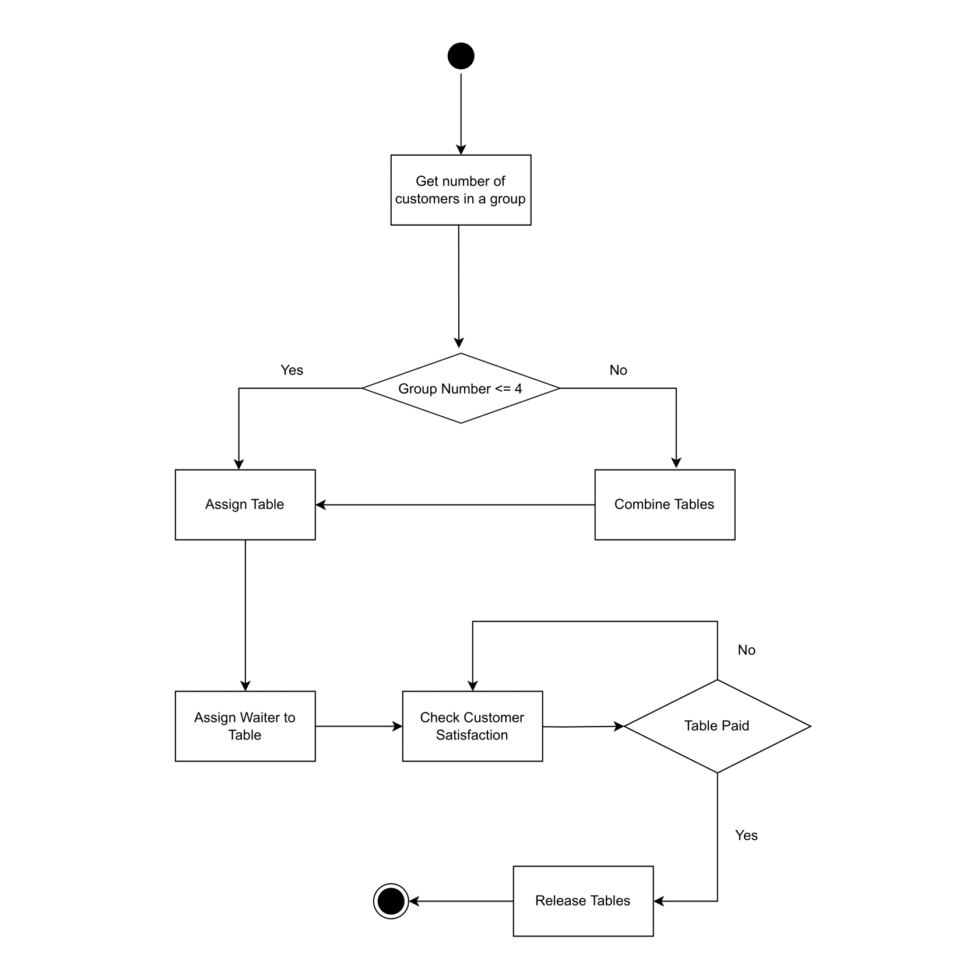
System Requirements
Manager
Manager should be able to :
Assign tables for customers
Build tables which can hold a maximum of four customers
Check on customer satisfaction

Slide 9
Builder
Each table in our restaurant can seat four customers
Should a group of customers be larger than 4 then the manager will have to combine them
Using the builder pattern, we can separate the construction of the table object from its representation so that the same construction process can create different representations of the tables

Slide 10
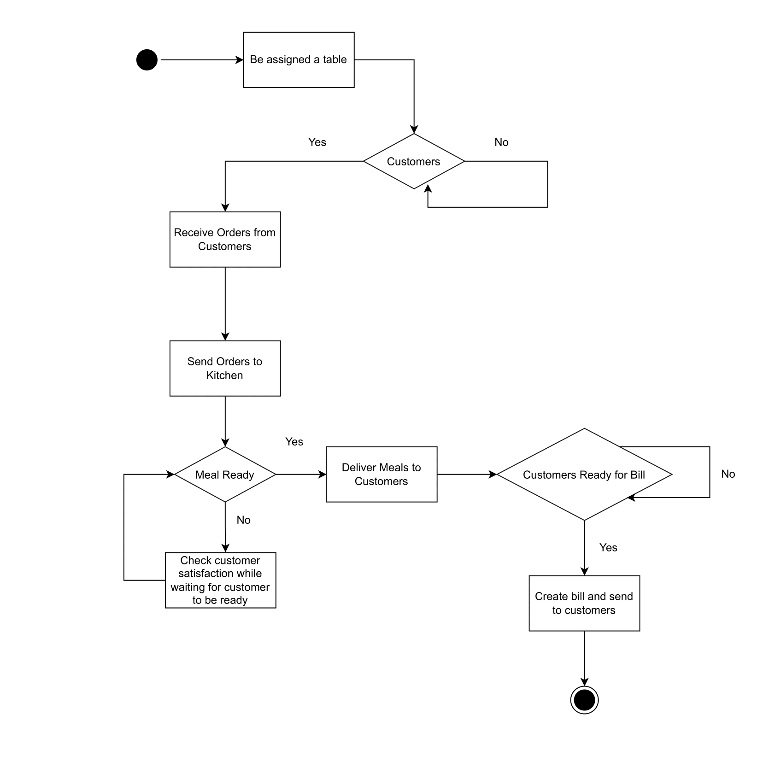
System Requirements
Waiter
Waiter should be able to :
Be assigned a table
Receive orders from customers
Take orders to the kitchen
Receive the meals from the kitchen and deliver them to the customers
Create bills and send them to customers
Observe customer satisfaction for the customers at their table

Slide 11
Mediator
The waiter has to facilitate communication between the head chef and the table by taking customer’s meals to and from the kitchen
Using the mediator pattern promotes loose coupling since it keeps the table and head chef objects from referring to each other explicitly, and it lets you vary the interaction independently.

Slide 12
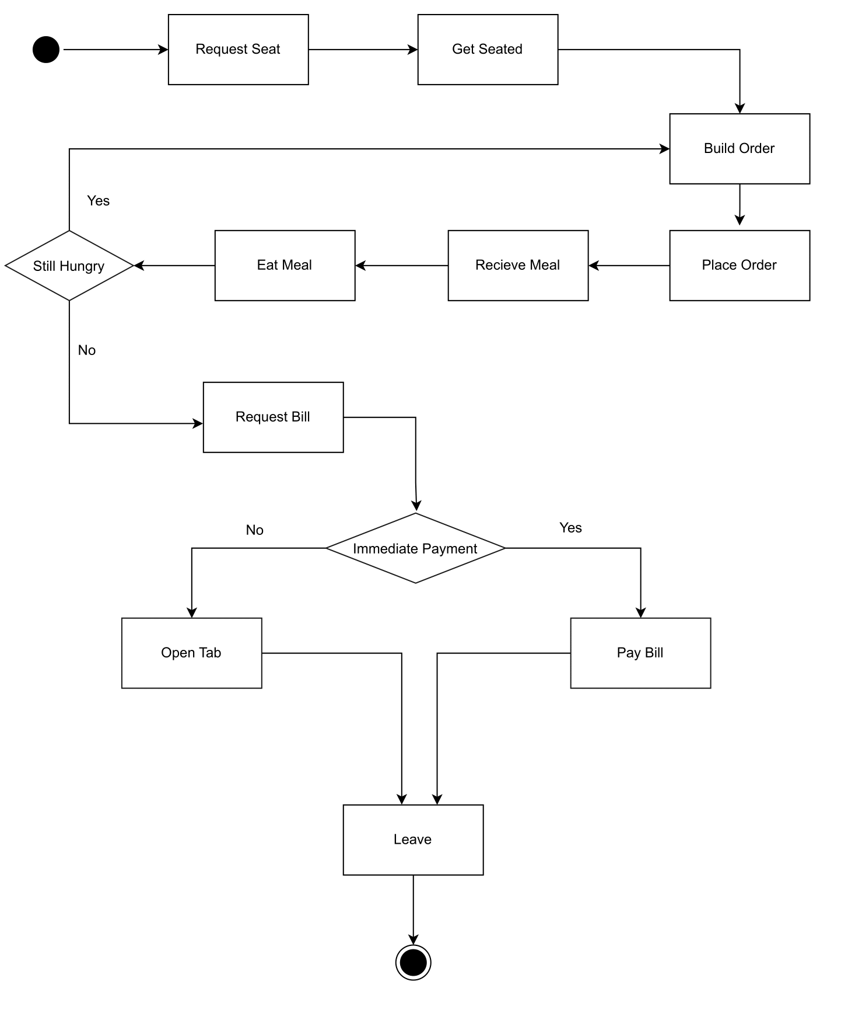
System Requirements
Customer
Customer should be able to :
Be assigned to a table
Create an order and then place it by sending it to the waiter
Specify ingredients and remove or add to the order prior to it being sent to the kitchen
Split the bill or pay it in full
Decide on payment method (by tab or pay immediately)
Receive their order and eat it

Slide 13
Memento
Prior to the order being sent to the kitchen to be created, the customer may wish to change their mind about their order
This means that a customer should be able to revert its order to a previous state should they so wish
We used the memento capture the order’s state so that the object can be restored to this state later

Slide 14
Strategy
In our restaurant, there are multiple ways of paying for the bill
Customers can either open a tab, split the bill, or pay the bill on their own
The strategy pattern allows us to ddefine a family of algorithms for paying the bill, and make the algorithms interchangeable since they accomplish the same thing.

Slide 15
Iterator
When the meals will be paid for by splitting the bill, we iterate through the customers object sequentially without exposing its underlaying representation

Slide 16
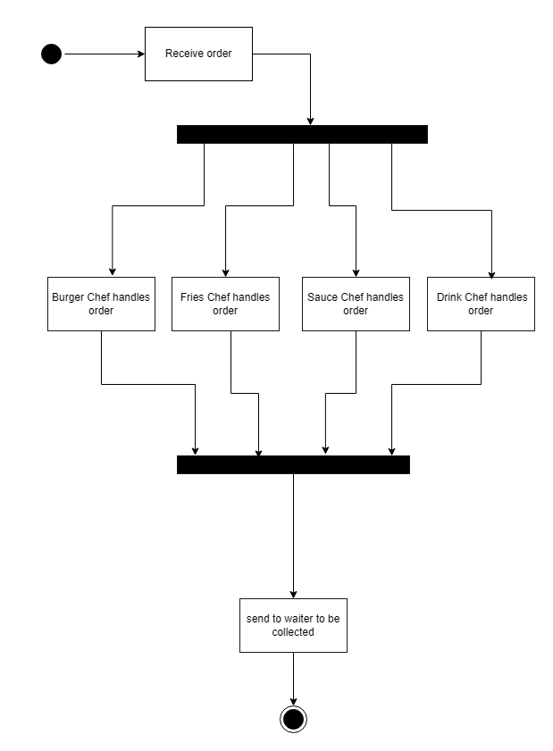
System Requirements
Chef
Chef should be able to :
Receive orders from waiters
Use order to construct meals
Head chef should plate food to be sent to waiter
Head chef also be able to observe customer satisfaction

Slide 17
Chain of Responsibility
Numerous chefs need to interact with the same order item and decide whether they have to create a product that corresponds to them
Using a chain of responsibility allows more than one object to handle the request (the ordered food) and this is a cleaner design since the sender of the meal isn’t coupled with the object(s) that receive the request

Slide 18
Decorator
Customers may order burgers but have to be able to specify what ingredients they may want in a burger (pickle, lettuce, patty or tomato)
The customer may want any combination of ingredients
The decorator pattern is a flexible alternative to subclassing for extending options customers have regarding what their burger is made up of

Slide 19
Factory Method
The drinks chef returns three different types of drinks and using the factory patter, we can define an interface for creating an the drink, but lets subclasses decide which class to instantiate

Slide 20
State
Over time the each table may be in different states
A table may be occupied, unoccupied, dirty or have its bill paid
We want a table to be able to alter its behaviour depending on what its internal state is.
The state pattern is used for exactly this.

Slide 21
Observer
Each table in the restaurant can either be satisfied or dissatisfied
The head chef, manager and waiters should all be able to observe whether the tables are satisfied or not
Using the observer pattern we define a one-to-many dependency between the restaurant tables and the staff members so that when a table changes its state, all its observers are notified and updated automatically

Slide 22
Final Class Diagram
Full System

Slide 23
Git & Coding Standards
The coding standards using in implementation and the workflows we used with git

Slide 24
Coding Standards
We researched the purpose and benefits of coding standards when beginning a collaborative project.
Coding standards were helpful in software development as they promote consistency, readability, and maintainability of code, making it easier for us to understand other developer’s work.
Additionally, adherence to coding standards can lead to reduced bugs (for example, one of our standards was having a single return line in order to limit possible points of errors in debugging).

Slide 25
Git Standards
Looking into the different work flows we could use while developing our project, we ended up choosing the Gitlow workflow to use.
This was because its release-based approach is intuitive and easy to understand.
We also appreciated that the Gitlow workflow has clear separation of branches, and dedicated branch for hotfixes, which would allow for efficient development.

